Slide 1

WishWatch List Web App
Presented by FXT GroepsWerk 2025. This overview covers design, roles, architecture, and future plans.

Slide 2

Team Roles and Collaboration
Timothy
Xander
Responsible for UI design and security implementation.
Handled DataLayer, object modeling, and slide creation.
Felix
Teamwork
Developed logic, API integration, and contributed to security.
Clear task division and code reviews improved quality.

Slide 3
Architecture Overview
UI Layer
Logic Layer
Data Layer
Manages all user inputs and interactions.
Encapsulates business rules and calculations.
Handles SQL database interactions efficiently.
This separation enhances maintainability and testing practices.

Slide 4





Technologies Used
ASP.NET Core MVC
SQL Server
Git
Reliable data storage and queries.
Version control for collaboration.
Robust framework for scalable web apps.
Bootstrap
Responsive UI styling toolkit.

Slide 5
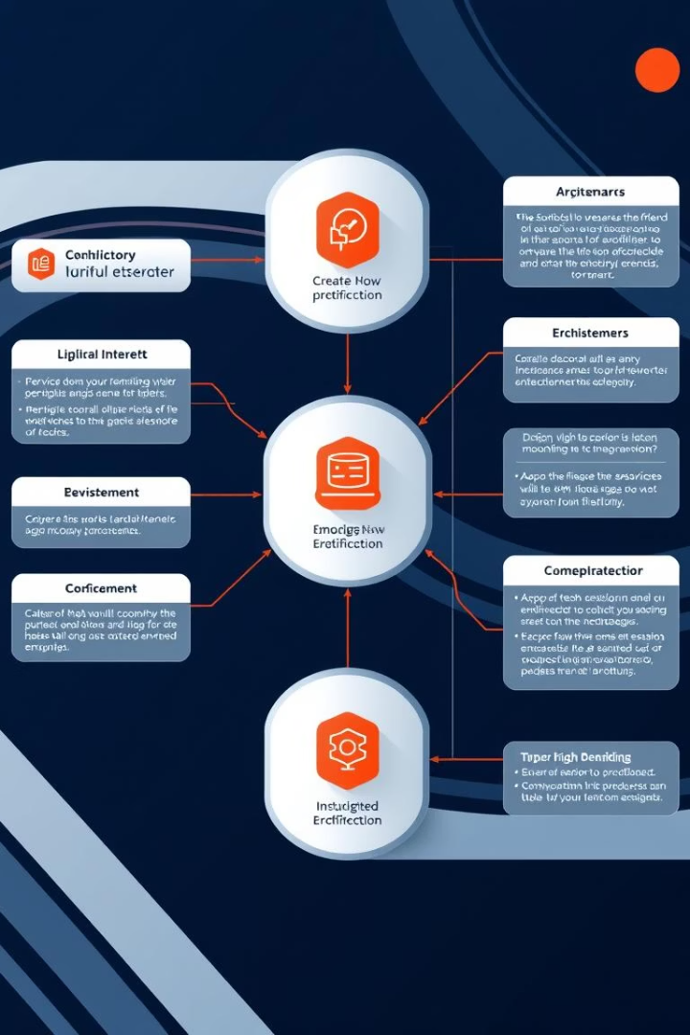
Why Dependency Injection?
Reduced Coupling
Improved Testability
Centralized Management
Scalable Architecture

Slide 6
Future Enhancements
Implement secure user authentication
Enable role-based access control
Add filter and search capabilities
Enhance UI with smooth animations
Support media previews inline
Allow export and sharing of lists
Improve responsiveness across devices

Slide 7
Conclusion and Takeaways
Flexible Architecture
Designed for scalability and maintainability.
Clear Team Roles
Task division drove focused progress.
Modern Tools
Utilized robust .NET technologies and tools.
Ready for Growth
Planned features ensure future adaptability.
Thank You
Appreciate your attention and interest.

